Slide 1
Progress Report (May 04, 2021)
JOEY Q. HARAP

Slide 2
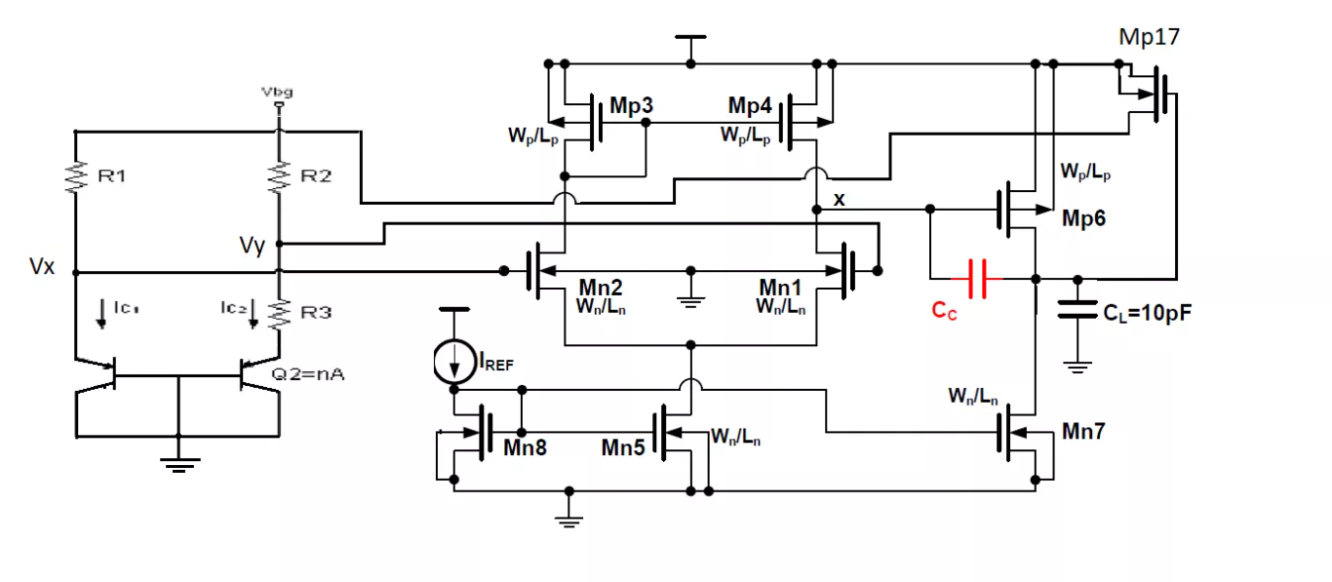
Voltage Bandgap Reference Circuit

Slide 3
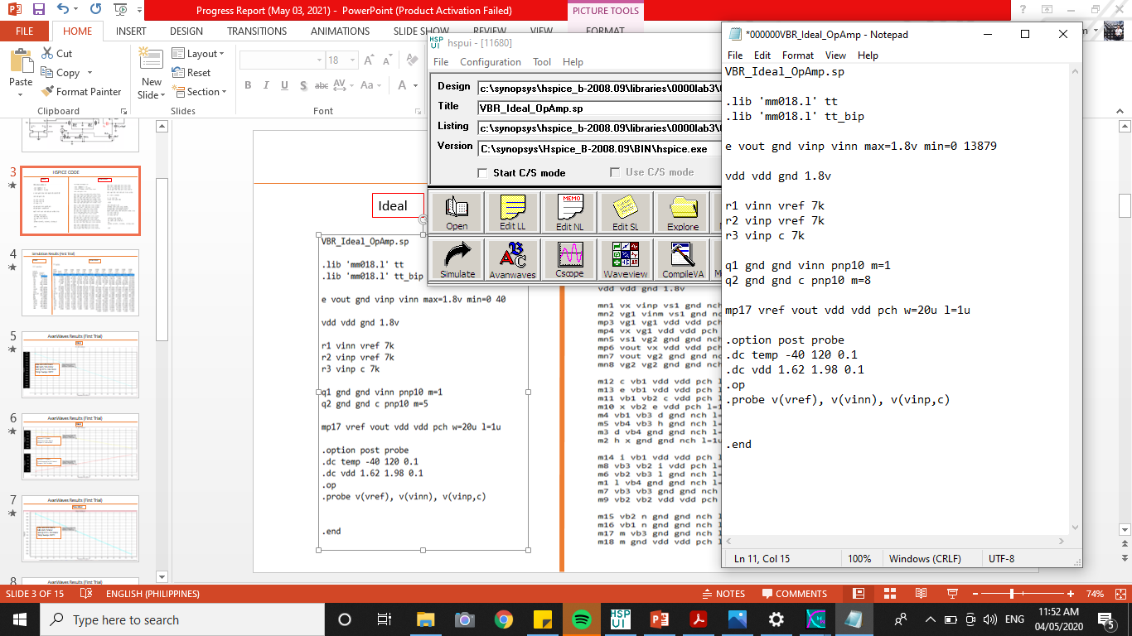
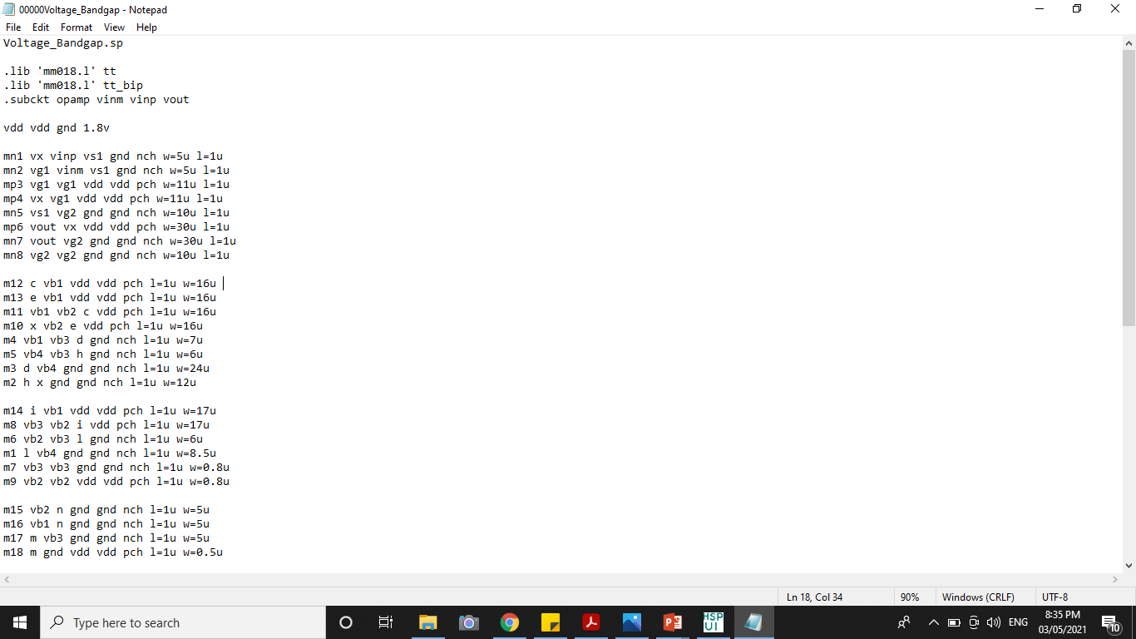
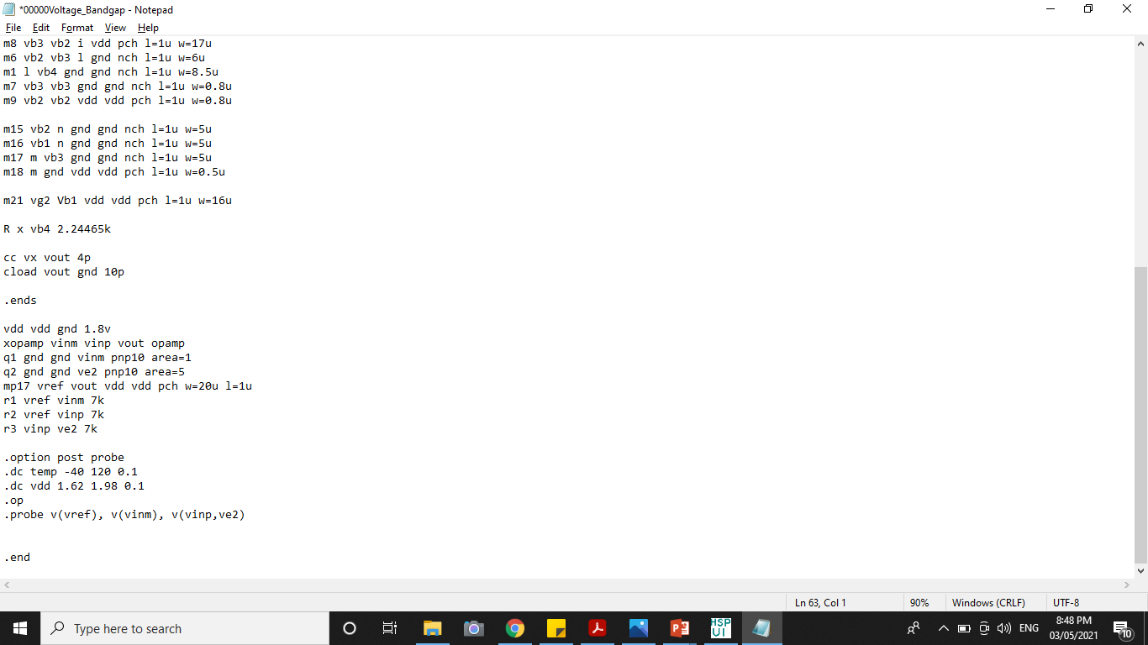
HSPICE CODE
Ideal
Non-Ideal

Slide 4
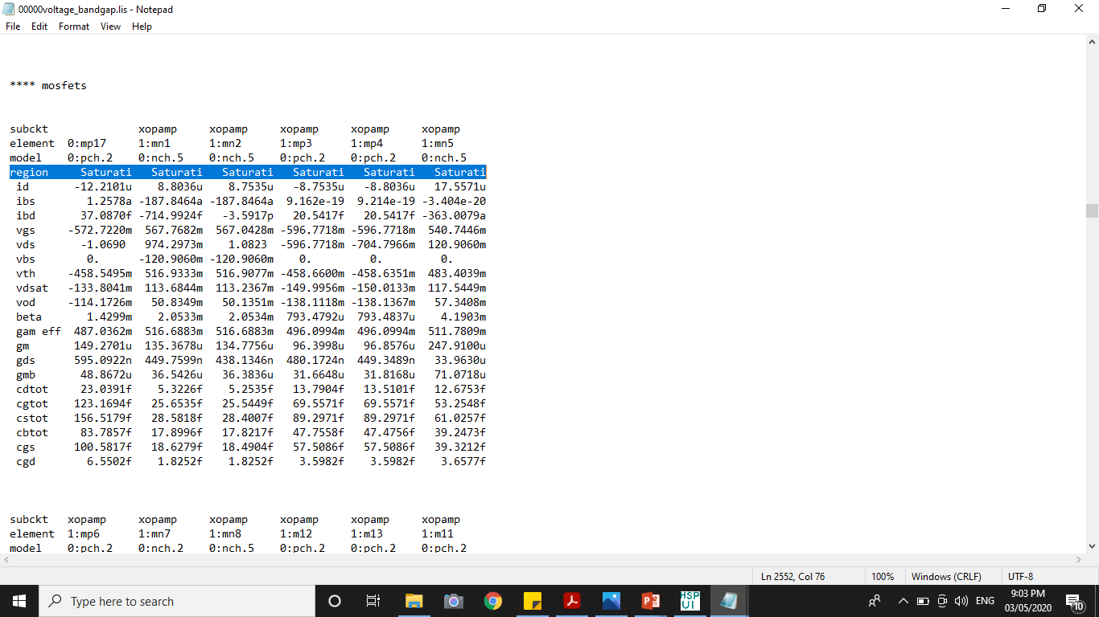
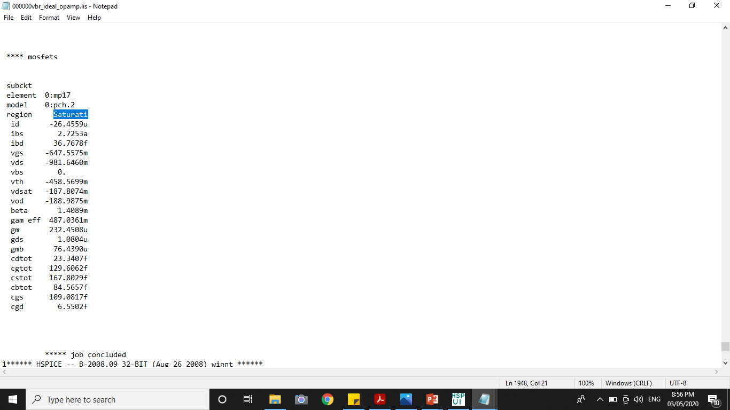
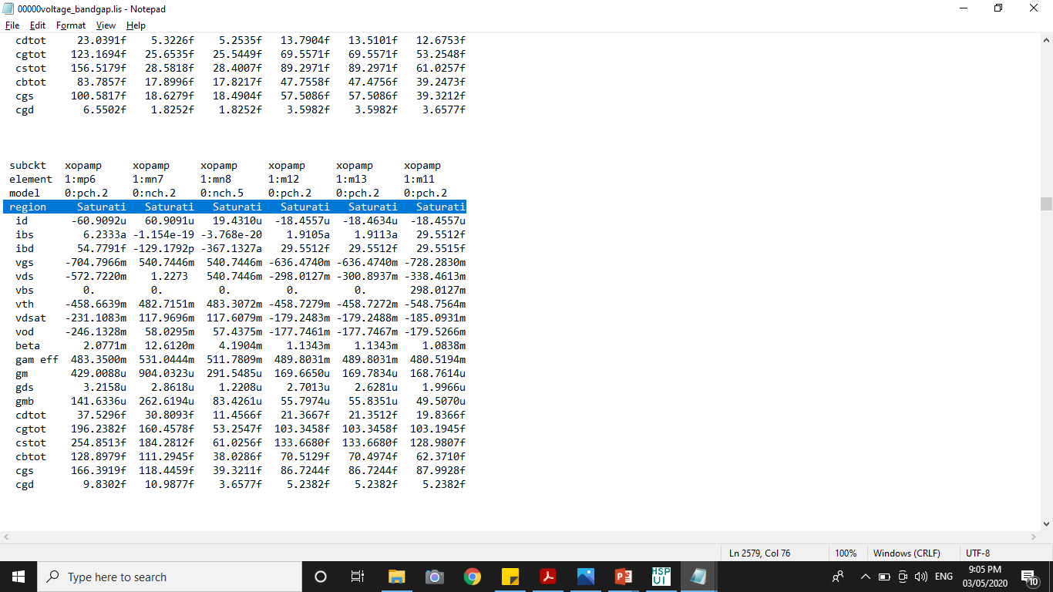
Simulation Results (First Trial)
Ideal
Non-Ideal

Slide 5
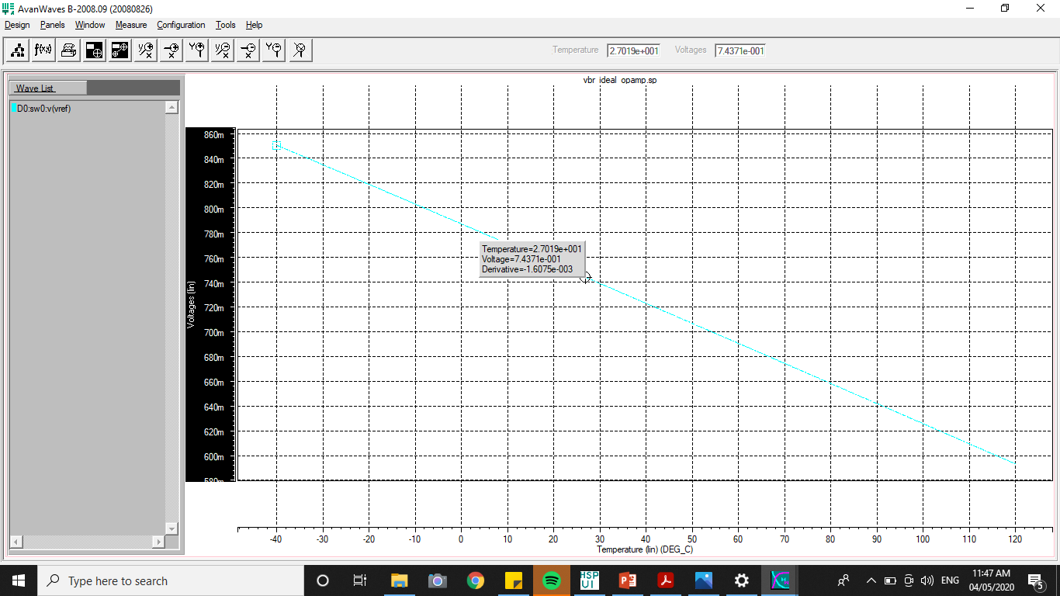
AvanWaves Results (First Trial)
Ideal
Max Vref=850.59mV
Min Vref= 593.17mV
Vref @ 27°C= 743.71mV
Temp. Sweep= 160°C

Slide 6
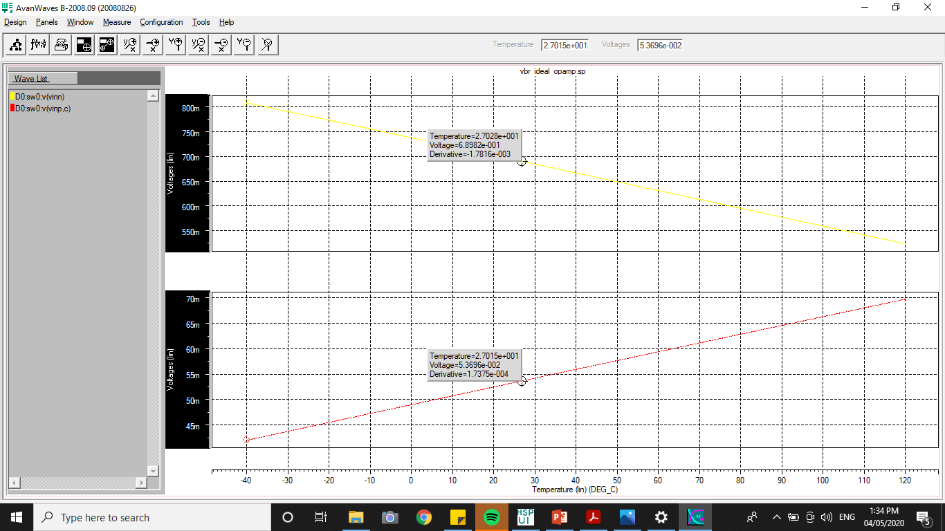
AvanWaves Results (First Trial)
Ideal
Temp=27°C/300K
Vbe=vinn=707.66mV
Slope=-1.7816e-003
Temp=27°C/300K
Vr3=(vinp-ve2)=78.514mV
Slope=1.7375e-004

Slide 7
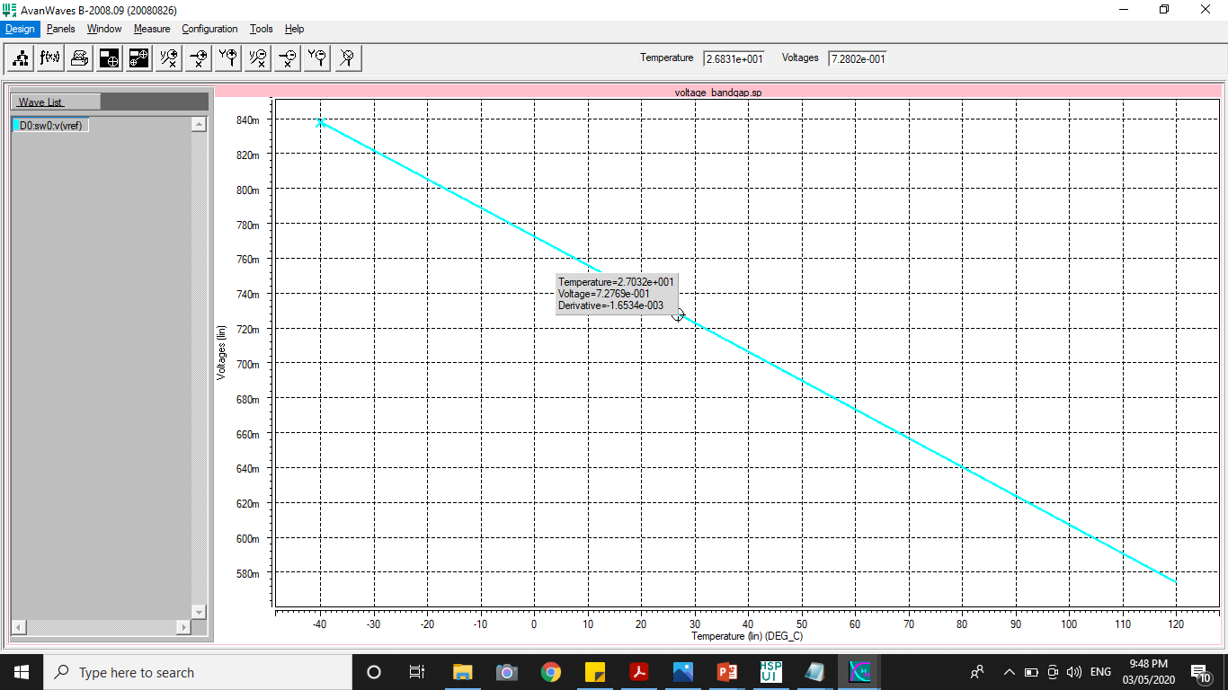
AvanWaves Results (First Trial)
Non-Ideal
Max Vref=837.96mV
Min Vref= 574mV
Vref @ 27°C= 727.69mV
Temp Sweep= 160°C

Slide 8
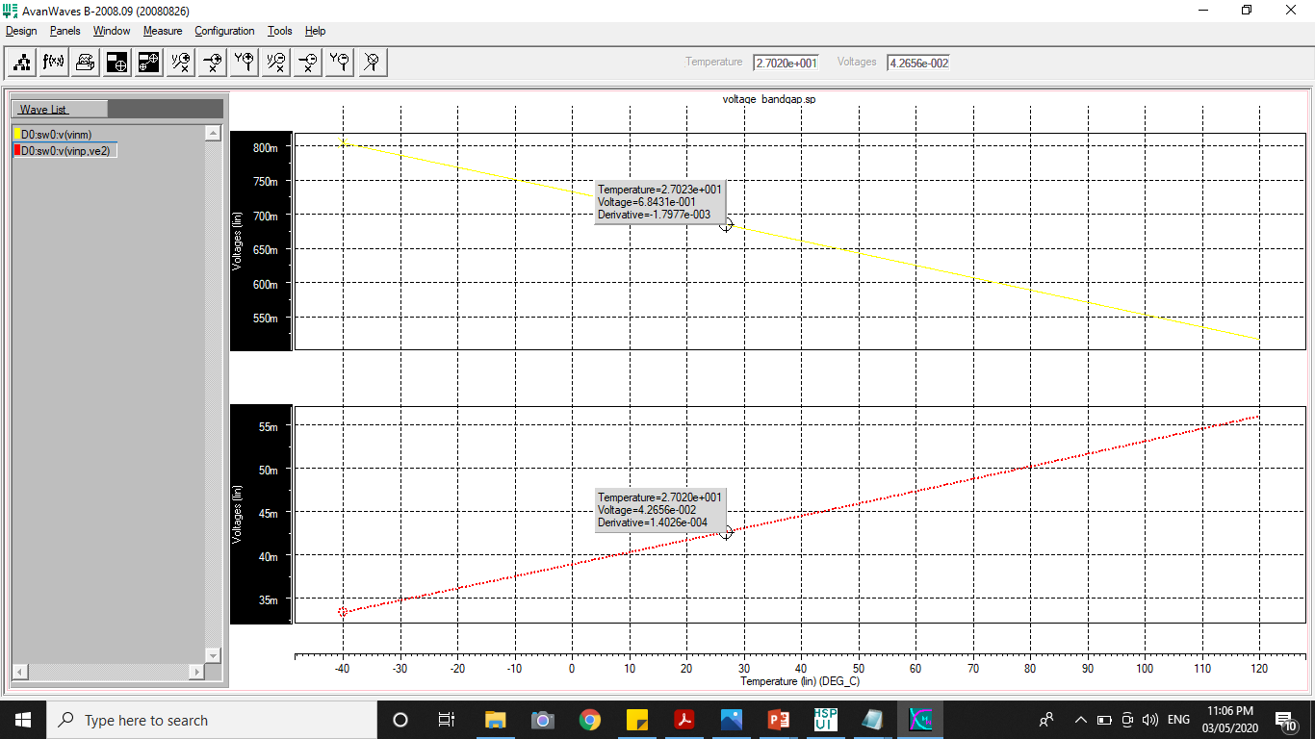
AvanWaves Results (First Trial)
Non-Ideal
Temp=27°C/300K
Vbe=vinn=684.31mV
Slope=-1.7977e-003
Temp=27°C/300K
Vr3=(vinp-ve2)=42.656mV
Slope=1.4026e-004

Slide 9






Temperature Coefficient (First Trial)
Ideal
Non-Ideal
$$Temp.C=\frac{{Vref}_{max}−{Vref}_{min}}{Temp Sweep ∗Vref @ 27°C}$$
$$Temp.C=\frac{{Vref}_{max}−{Vref}_{min}}{Temp Sweep ∗Vref @ 27°C}$$
$$Temp.C=\frac{850.59mV−593.17mV}{160∗743.71mV}$$
$$Temp.C=\frac{837.96mV−574mV}{160∗727.69mV}$$
$$Temp.C=2163.3 ppm/°C$$
$$Temp.C=2267.1 ppm/°C$$

Slide 10








Solving for the Final Resistor Values
Ideal
Non-Ideal
$$\frac{∂Vref}{∂T}=α1\frac{∂Vbe}{∂T}+α2\frac{∂Vr3}{∂T}$$
$$\frac{∂Vref}{∂T}=α1\frac{∂Vbe}{∂T}+α2\frac{∂Vr3}{∂T}$$
$$\frac{∂Vref}{∂T}=0=−1.7816x{10}^{−3}+1.7375x{10}^{−4}(\frac{R1}{R3})$$
$$\frac{∂Vref}{∂T}=0=−1.7977x{10}^{−3}+1.4026x{10}^{−4}(\frac{R1}{R3})$$
$$R1=R2=10.25(R3)$$
$$R1=R2=12.82 (R3)$$
$$R1=R2=71.75 kohm$$
$$R1=R2=89.72 kohm$$

Slide 11
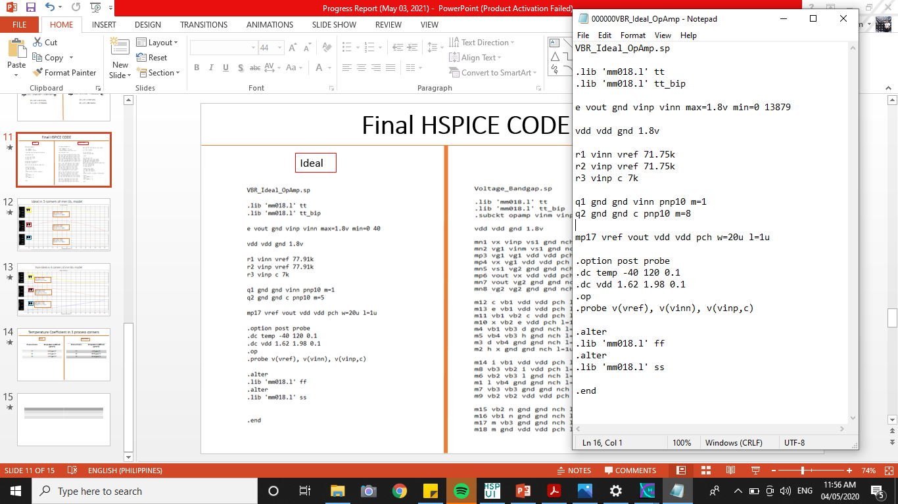
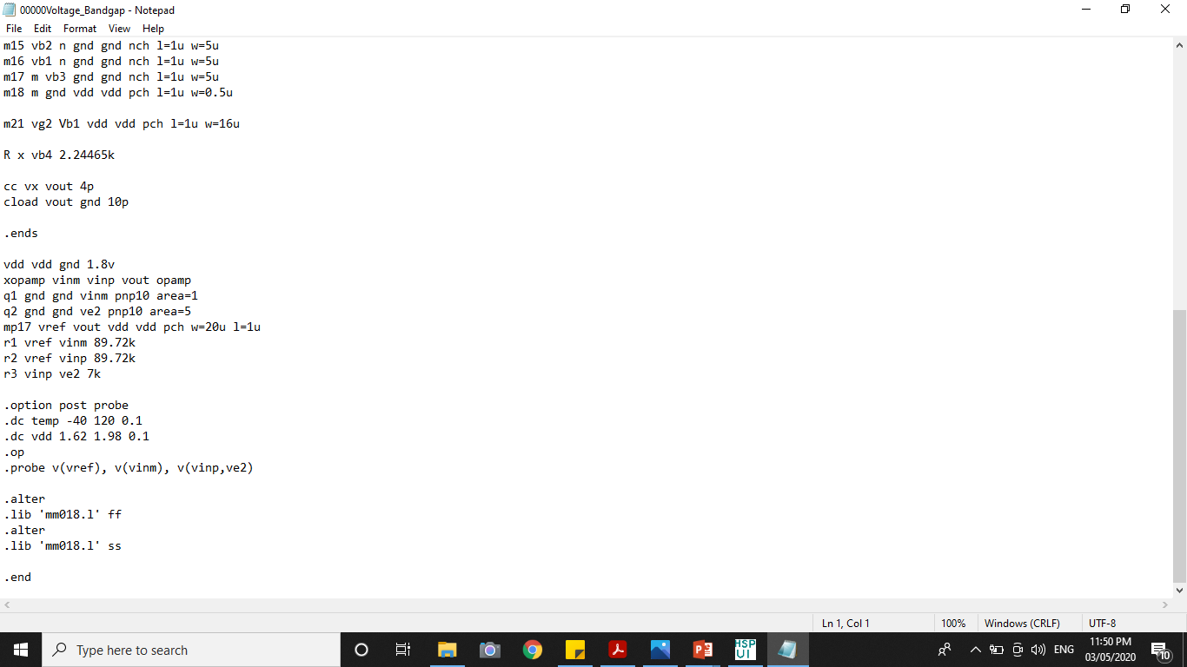
Final HSPICE CODE
Ideal
Non-Ideal

Slide 12
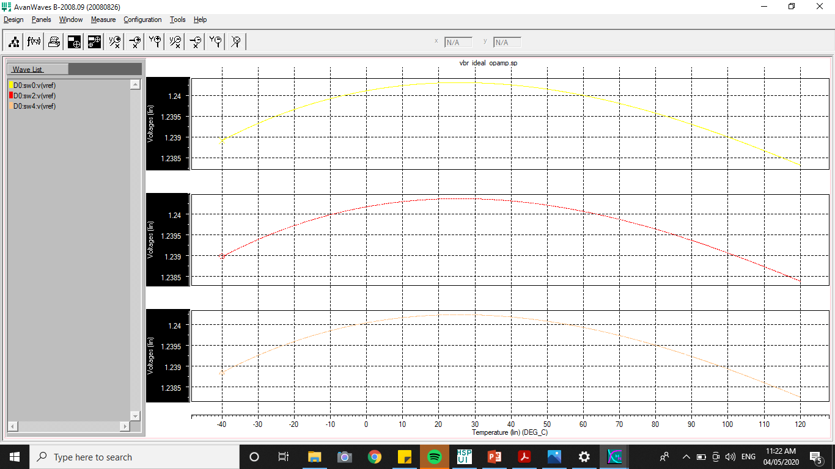
Ideal in 3 corners of mm lib. model
T T
Max Vref=1.2389V
Min Vref=1.2383V
Vref @ 27°C= 1.2403V
F F
Max Vref=1.2390V
Min Vref=1.2384V
Vref @ 27°C= 1.2404V
S S
Max Vref=1.2388V
Min Vref= 1.2383V
Vref @ 27°C= 1.2402V

Slide 13
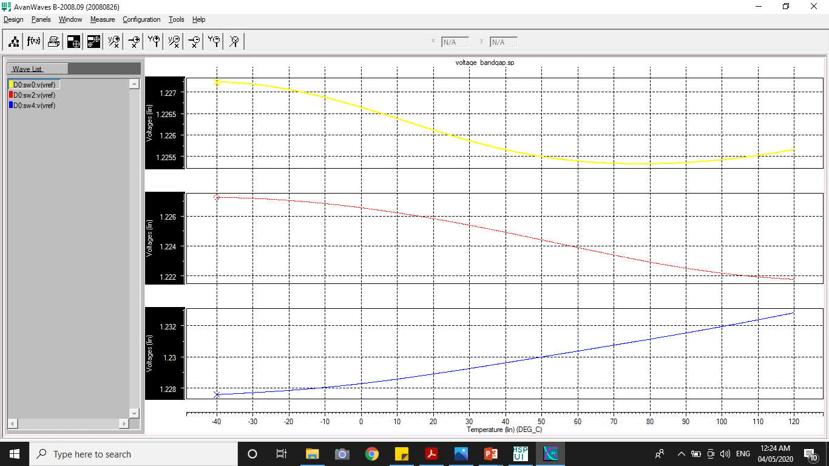
Non-Ideal in 3 corners of mm lib. model
T T
Max Vref=1.2266V
Min Vref=1.2257V
Vref @ 27°C= 1.2259V
F F
Max Vref=1.2273V
Min Vref=1.2218V
Vref @ 27°C= 1.2255V
S S
Max Vref=1.2328V
Min Vref= 1.2276V
Vref @ 27°C= 1.2291V

Slide 14

Temperature Coefficient in 3 process corners
Ideal
Non-Ideal
$$Temp.C=\frac{{Vref}_{max}−{Vref}_{min}}{Temp Sweep ∗Vref @ 27°C}$$
$$Temp.C=\frac{{Vref}_{max}−{Vref}_{min}}{Temp Sweep ∗Vref @ 27°C}$$
Process Corners | Temperature Coefficient (ppm/°C)
TT | 3.02 ppm/°C
FF | 3.02 ppm/°C
SS | 2.52 ppm/°C
Process Corners | Temperature Coefficient (ppm/°C)
TT | 5 ppm/°C
FF | 28.05 ppm/°C
SS | 26.44 ppm/°C

Slide 15
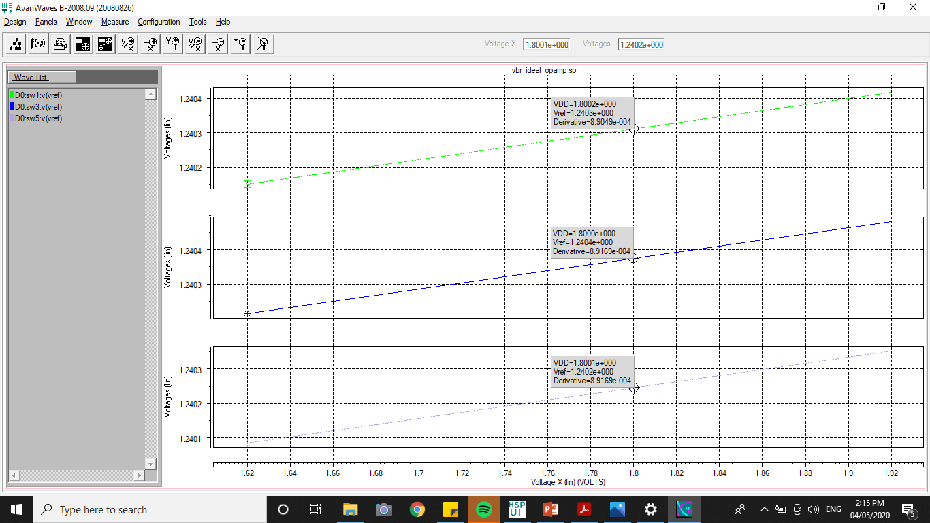
Sensitivity to VDD change (Ideal OpAmp)
T T
F F
S S

Slide 16
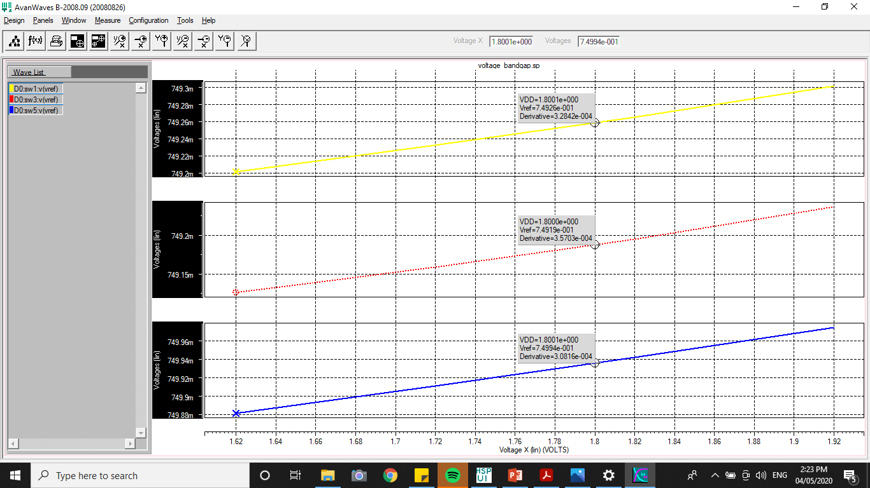
Sensitivity to VDD change (Non-Ideal OpAmp)
T T
F F
S S

Slide 17


Sensitivity in 3 process corners
Ideal
Non-Ideal
$$S(\frac{Vref}{Vdd})=\frac{Vdd}{Vref}×\frac{∂Vref}{∂Vdd}×100$$
$$S(\frac{Vref}{Vdd})=\frac{Vdd}{Vref}×\frac{∂Vref}{∂Vdd}×100$$
Process Corners | Sensitivity to VDD Change
TT | 0.129%
FF | 0.129%
SS | 0.129%
Process Corners | Sensitivity to VDD Change
TT | 0.079%
FF | 0.086%
SS | 0.074%

Slide 18
Thnks

